Slide 1
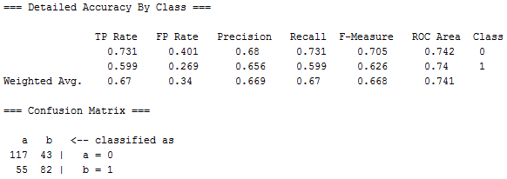
Sometimes fewer attributes is better if they are optimal
Weka’s Logistic Regression
a b
143 17 | a=0
29 108 | b=1
Weka’s Logistic with the same set of attributes
that gave the best result in Simple Logistic

Slide 2
Feature Selection by Genetic algorithm
Feature selection: Chose k<d important features, ignore the remaining d – k
Data snooping (not a good idea)
Genetic algorithm
Feature extraction: Project the original d attributes onto a new k<d dimensional feature space
Principal components analysis (PCA),
Linear discriminant analysis (LDA),
Factor analysis (FA)
Auto-association ANN

Slide 3
Very Brief History of genetic algorithms:
Genetic Algorithms were developed by John Holland in
60’s and 70’s
Author of “Adaption in Natural and Artificial Systems”
More recent book on the subject
“An Introduction to Genetic Algorithms” by Melanie Mitchell
(MIT Press, Cambridge, MA, 2002)

Slide 4
Natural adaption:
Populations of organisms are subjected to environmental
stress.
Fitness is manifest by ability to survive and reproduce
Fitness is passed to offspring by genes that are organized
on chromosomes.
If environmental conditions change, evolution creates a
new population with different characteristics that optimize
fitness under the new conditions

Slide 5
Basic tools of evolution
Recombination (crossover) occurs during reproduction.
Chromosome of offspring is a mixture of chromosomes
from parents
Mutation changes a single gene within a chromosome.
To be expressed, organism must survive and pass modified
chromosome to offspring

Slide 6
Artificial adaptation :
Represent a candidate solution to a problem by a chromosome
Define a fitness function on the domain of all chromosomes
Define the probabilities of crossover and mutation.
Select 2 chromosomes for reproduction based on their fitness
Produce new chromosomes by crossover and mutation
Evaluate fitness of new chromosomes
Completes a “generation”

Slide 7
Artificial adaptation continued:
In 50-500 generations create a population of solutions
with high fitness
Repeat whole process several times and merge best
solutions
Simple example: Find the position of the maximum of
a normal distribution with mean of 16 and standard
deviation of 4
Of course, this problem could be solved by differential
calculus. GA method for illustration only.

Slide 8
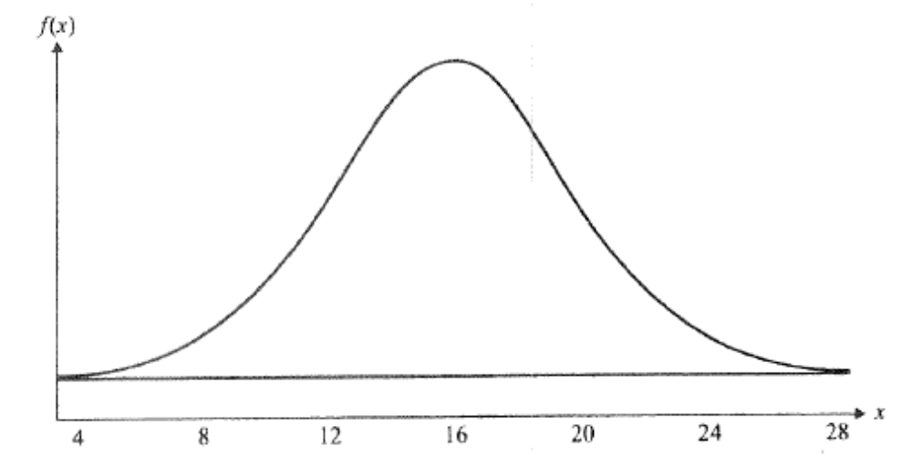
Fitness function
Obvious that maximum is at 16. We will discover this by GA.

Slide 9
Problem set up
Chromosome = binary representation of integers
between 0 and 31 (requires 5 bits)
0 to 31 covers the range where fitness is significantly
different from zero
Fitness of chromosome = value of fitness function f(x)
where x is integer equivalent of a 5-bit binary
Crossover probability (rate) = 0.75
Mutation probability (rate) = 0.002
Size of population, n = 4

Slide 10
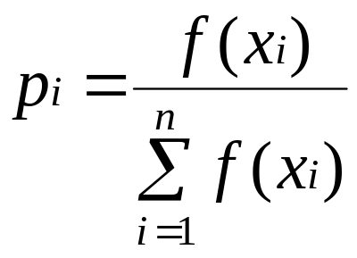
Method to select chromosomes for refinement
Calculate fitness f(x_{i}) for each chromosome in population
Assigned each chromosome a discrete probability by
Use p_{i} to design a roulette wheel
Divide number line between 0 and 1 into segments of length
p_{i} in a specified order
Get r, random number uniformly distributed between 0 and 1
Choose the chromosome of the line segment containing r

Slide 11
1st generation: 5-bit binary numbers chosen randomly
00100 = 4 fitness = 0.0011 pi = 0.044
01001 = 9 fitness = 0.0216 pi = 0.861
11011 = 27 fitness = 0.0023 pi = 0.091
11111 = 31 fitness = 0.0001 pi = 0.004
Σ_{i} f(x_{i}) = 0.0251
Assume the pair with greatest fitness (01001 and 11011)
are selected for replication

Slide 12
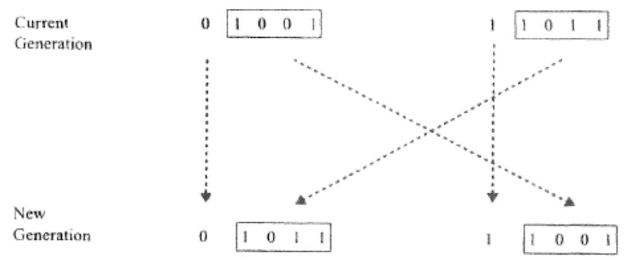
Crossover selected to induce change
Assume a mixing point (locus) is chosen between first and
second bit.
Mutation is rejected as method to induce change

Slide 13
Evaluate fitness of new population
00100 = 4 fitness = 0.0011 pi = 0.0201
01011 = 11 fitness = 0.0457 pi = 0.8339
11001 = 25 fitness = 0.0079 pi = 0.1442
11111 = 31 fitness = 0.0001 pi = 0.0018
Σ_{i} f(x_{i}) = 0.0548 about 2 times that of the 1st generation
Repeat until fitness of population is almost uniform
Values of all chromosomes should be near 16

Slide 14
Crowding:
In the initial chromosome population of this example
01001 has 86% of the selection probability.
Potentially can lead to imbalance of fitness over diversity
Limits the ability of GA to explore new regions of search space
Solution: penalize choice of similar chromosomes for mating

Slide 15
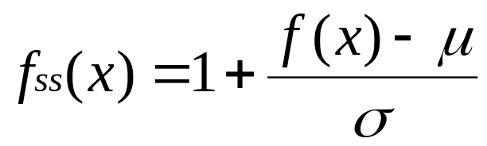
Sigma scaling allows variable selection pressure
Sigma scaling of fitness f(x)
μ and σ are the mean and standard deviation of
fitness in the population
In early generations, selection pressure should be low to
enable wider coverage of search space (large σ)
In later generations selection pressure should be higher to
encourage convergence to optimum solution (small σ)

Slide 16
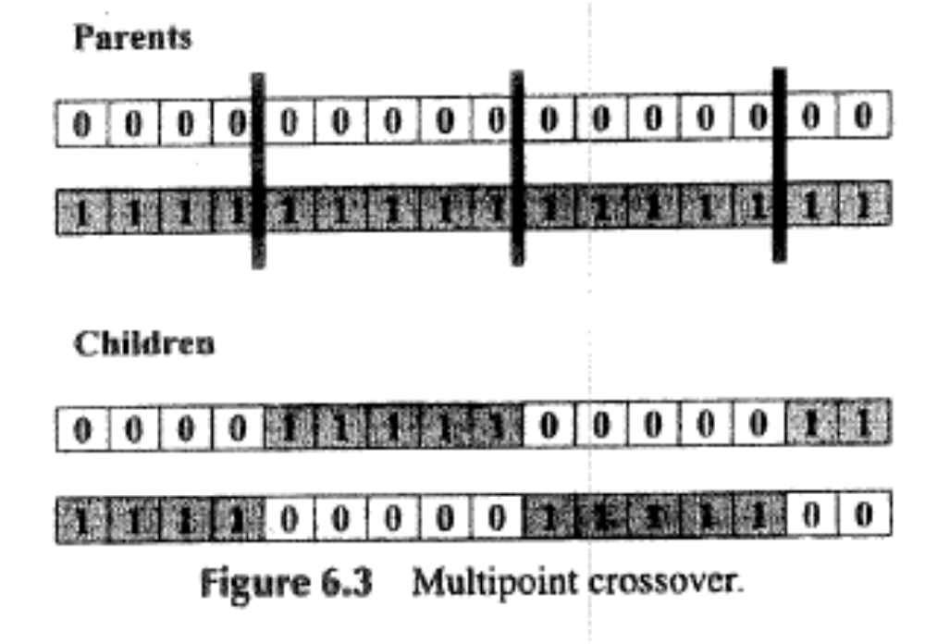
Positional bias: Single-point crossover lets
near-by loci stay together in children
One of several methods to avoid positional bias

Slide 17
Genetic Algorithm for real-valued variables
Real-valued variables can be converted to binary
representation as in example of finding maximum
of normal distribution.
Results in loss of significance unless one uses a
large number of bits
Arithmetic crossover
Parents <x₁, x₂,…x_{n}> and <y₁, y₂, …y_{n}>
Choose k^{th} gene at random
Children <x₁, x₂,…αy_{k} +(1-α)x_{k},…x_{n}>
<y₁, y₂,…αx_{k} +(1-α)y_{k},…y_{n}> 0 < α <1

Slide 18
More methods for real-valued variables
Discrete crossover: With uniform probability, each gene
of child chromosome chosen to be a gene in one or the
other parent chromosomes at the same locus.
Parents <0.5, 1.0, 1.5, 2.0> and <0.2, 0.7, 0.2, 0.7>
Child <0.2, 0.7, 1.5, 0.7>
Normally distributed mutation:
Choose random number from normal distribution with zero
mean and standard deviation comparable to size of genes
(e.g. σ = 1 for genes scaled between -1 and +1).
Add to randomly chosen gene. Re-scale if needed.

Slide 19
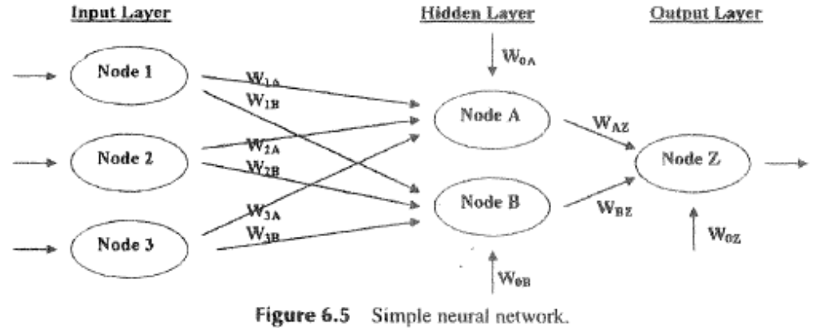
Using GA in training of ANN
ANN with 11 weights: 8 to hidden layer, 3 to output
w_{1A} w_{1B} w_{2A} w_{2B} w_{3A} w_{3B} w_{0A} w_{0B} w_{AZ} w_{BZ} w_{0Z}

Slide 20
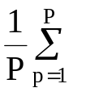
Chromosome for weight optimization by GA
< w_{1A} w_{1B} w_{2A} w_{2B} w_{3A} w_{3B} w_{0A} w_{0B} w_{AZ} w_{BZ} w_{0Z >}
Scaled to values between -1 and +1
Use methods crossover and mutation for real numbers to
modify chromosome
Fitness function: mean squared deviation between
output and target

Slide 21
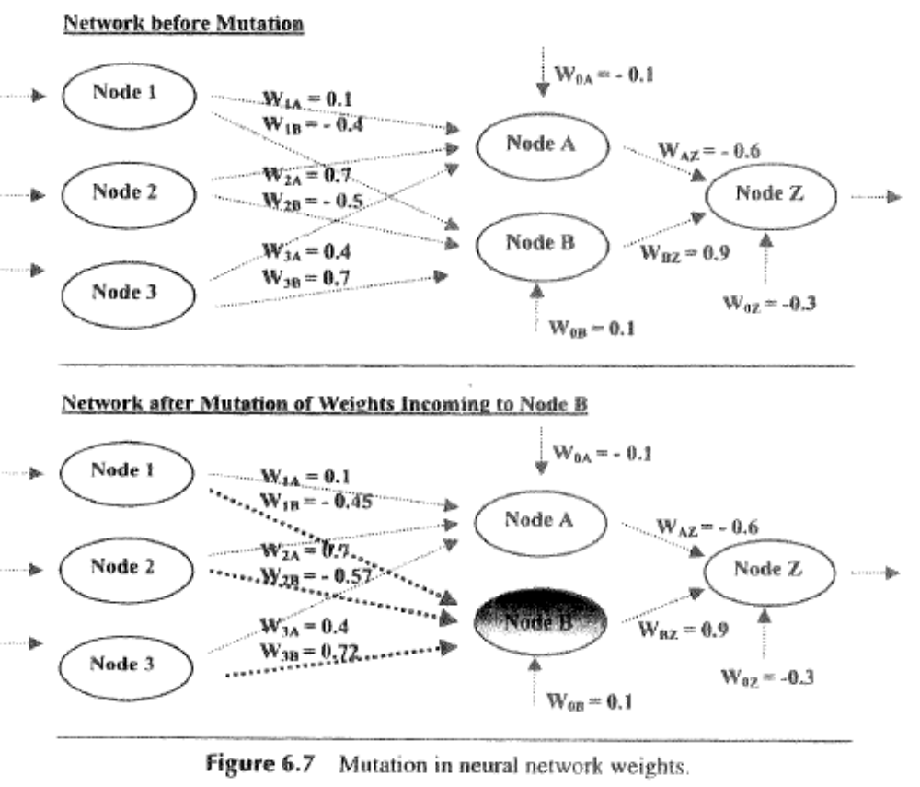
Use feed forward to determine the fitness of this new chromosome

Slide 23
Genetic algorithm for attribute selection
Find the best subset of attributes for data mining
GA is well suited to this task since, with diversity, it can explore many combinations of attributes.

Slide 24
WEKA’s GA applied to attribute selection
Default values:
Population size = 20
Crossover probability = 0.6
Mutation probability = 0.033
Example: breast-cancer classification
Wisconsin Breast Cancer Database
Breast-cancer.arff
683 instances
9 numerical attributes
2 target classes
benign=2
malignant=4

Slide 25
Examples from dataset
Severity scores
5,1,1,1,2,1,3,1,1,2
5,4,4,5,7,10,3,2,1,2
3,1,1,1,2,2,3,1,1,2
6,8,8,1,3,4,3,7,1,2
4,1,1,3,2,1,3,1,1,2
8,10,10,8,7,10,9,7,1,4
1,1,1,1,2,10,3,1,1,2
2,1,2,1,2,1,3,1,1,2
2,1,1,1,2,1,1,1,5,2
4,2,1,1,2,1,2,1,1,2
Tumor characteristics
clump-thickness
uniform-cell size
uniform-cell shape
marg-adhesion
single-cell size
bare-nuclei
bland-chomatin
normal-nucleoli
mitoses
Severity scores are attributes
Last number in a row is class label

Slide 26
Severity score
5,1,1,1,2,1,3,1,1,2
5,4,4,5,7,10,3,2,1,2
3,1,1,1,2,2,3,1,1,2
6,8,8,1,3,4,3,7,1,2
4,1,1,3,2,1,3,1,1,2
8,10,10,8,7,10,9,7,1,4
1,1,1,1,2,10,3,1,1,2
2,1,2,1,2,1,3,1,1,2
2,1,1,1,2,1,1,1,5,2
4,2,1,1,2,1,2,1,1,2
Characteristic
clump-thickness
uniform-cell size
uniform-cell shape
marg-adhesion
single-cell size
bare-nuclei
bland-chomatin
normal-nucleoli
mitoses
Chromosomes have 9 binary genes
gene_{k} = 1 means k^{th} severity score included
Fitness: accuracy of naïve Bayes classification

Slide 27
Attribute selection using WEKA’s genetic algorithm method
Open file breast-cancer.arff
Check attribute 10 (class) to see the number of
examples in each class

Slide 28
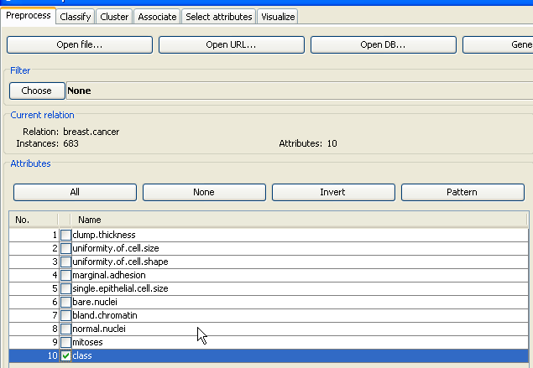

Slide 29
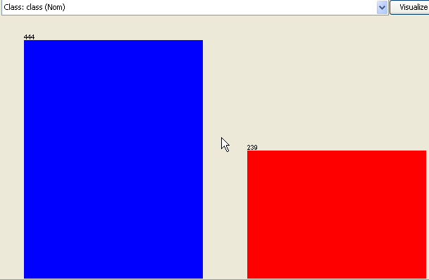
benign
malignant

Slide 30
Attribute selection using WEKA’s genetic algorithm method
Open file breast-cancer.arff
Click on attribute 10 (class) to see the number of
examples in each class
Click on any other attribute.

Slide 31
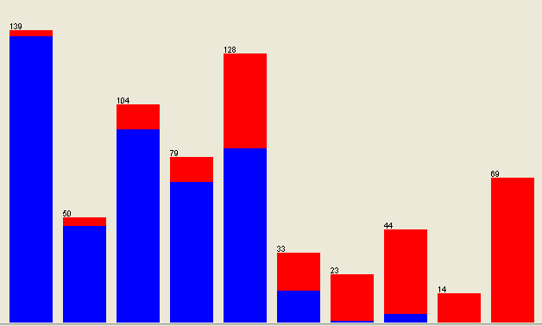
clump thickness
increasing severity →
Distribution of severity scores (1 – 10) over examples in dataset
Severity of clump thickness positively correlated with malignancy

Slide 32
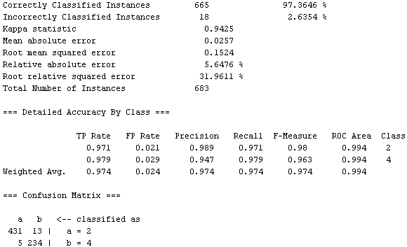
Baseline performance measures use naïve Bayes classifier

Slide 33

Under the Select-Attributes tab of Weka Explorer
Press choose button under Attribute Evaluator
Under Attribute Selection find WrapperSubsetEval

Slide 34
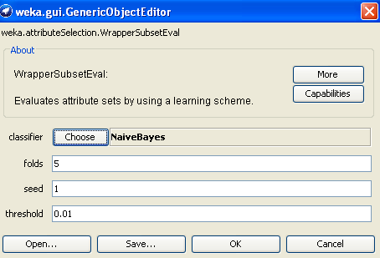
Click on WrapperSubsetEval to bring up dialog box
which shows ZeroR as the default classifier
Find the Naïve Bayes classifier, click OK
Evaluator has been selected

Slide 35
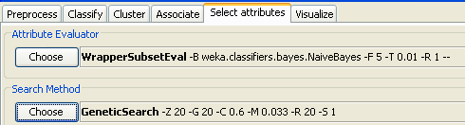
Under the Select-Attribute tab of Weka Explorer
Press choose button under Search Method
Find Genetic Search (see package manager in
Weka 3.7)
Start search with default settings including
“Use full training set”

Slide 36
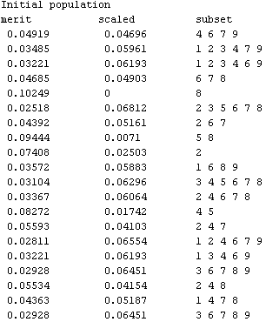
How is subset related to chromosome?
Fitness function:
linear scaling of
the error rate
of naïve Bayes
classification
such that the
highest error rate
corresponds to a
fitness of zero

Slide 37
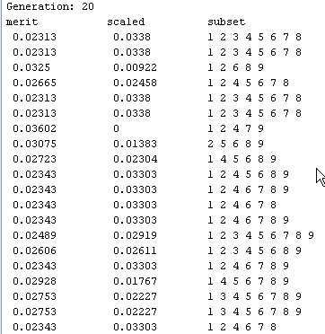
Results with Weka 3.6
Subset that include 9th attribute have low fitness

Slide 38
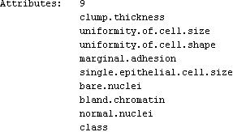
Increasing the number of generations to 100
does not change the attributes selected
9th attribute “mitoses” has been deselected
Return to Preprocess tab, remove “mitoses”
and reclassify

Slide 39

Performance with reduced attribute set is slightly improved
Slight improvement
Misclassified malignant cases
decreased by 2

Slide 40
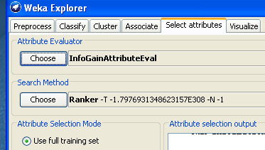
Weka has other attribute selection techniques
For theory see
http://en.wikipedia.org/wiki/Feature_selection
“information gained” is alternative to SubSetEval with GA search
Ranker is the only Search Method that can be used
with InfoGainAttributeEval

Slide 41
Assignment 8 due 11-1-16
Use the information-gain ranking filter on the leukemia gene
expression dataset from assignment #1to find the top-5 genes.
Use IBk (K=5) with these 5 attributes to classify AML vs ALL.
Compare performance with results from HW1 where all genes
were used for classification.

